Slide 1

Package Authoring Best Practices

Slide 2
Semantic Versioning
Use semantic versioning to version your NuGet package
Major.Minor.Patch[-suffix]
Major: Breaking changes
Minor: New features, but backwards compatible
Patch: Backwards compatible bug fixes only
-Suffix (optional): a hyphen followed by a string denoting a pre-release version

Slide 3
Other Metadata to include
Use the author field for yours or your organizations "pretty name", and not an abbreviation
"jdoe" vs "Jane Doe" or "ContosoToolKit" vs. "Contoso Corporation"
Include a short description to describe what your package is and does
Include a link to an associated project, repository, or company website (Consider using SourceLink)
Include an icon with your package
Include a package license
Include release notes
Include a high quality, informative README file

Slide 4
README
This is likely one of the first elements users will see when they view your package details page on NuGet.org and is essential to making a good impression!
What should my README file include?
An introduction to what your package is and does - what problems does it solve?
How to get started with your package - are there any specific requirements?
Links to more comprehensive documentation if not included in the readme itself.
At least a few code snippets/samples or example images.
Where and how to leave feedback such as link to the project issues, Twitter, bug tracker, or other platform.
How to contribute, if applicable.

Slide 5
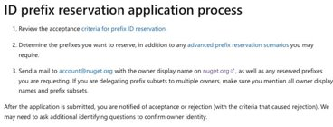
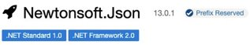
Prefix Reservation
Package owners can reserve and protect their identity by reserving ID prefixes

Slide 6
Package Consumption Best Practices

Slide 7
How do I determine which package I should download?
Let's take a look at an example of some packages in the NuGet ecosystem to get an idea of what to look for!

